Slide 1
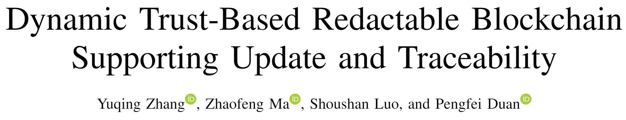
——方泓力

Slide 2
Contents
Preliminaries
Dynamic Trust Worthiness
Construction of DTCH
System Model
Performance Analysis

Slide 3
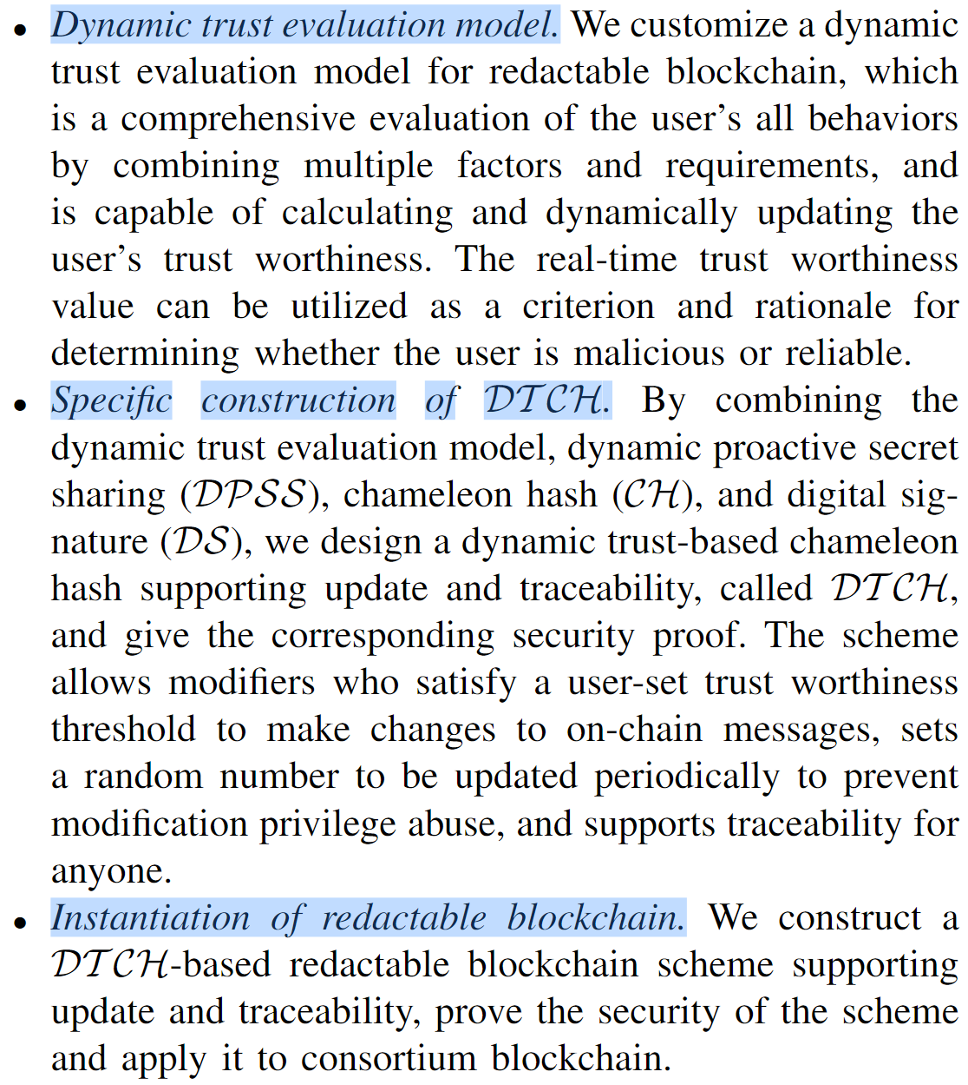
Contribution

Slide 4
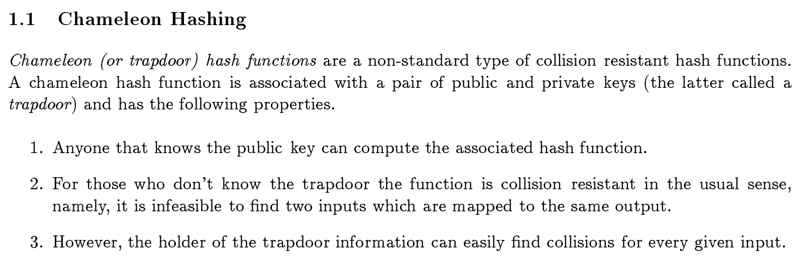
1Preliminaries-Chameleon Hash

Slide 5
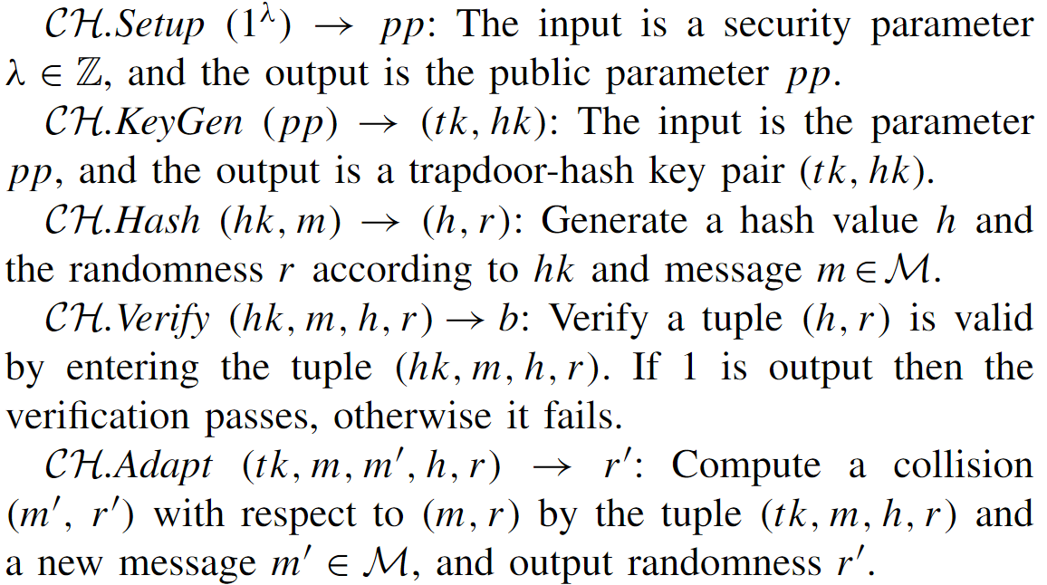
1Preliminaries-Chameleon Hash

Slide 6
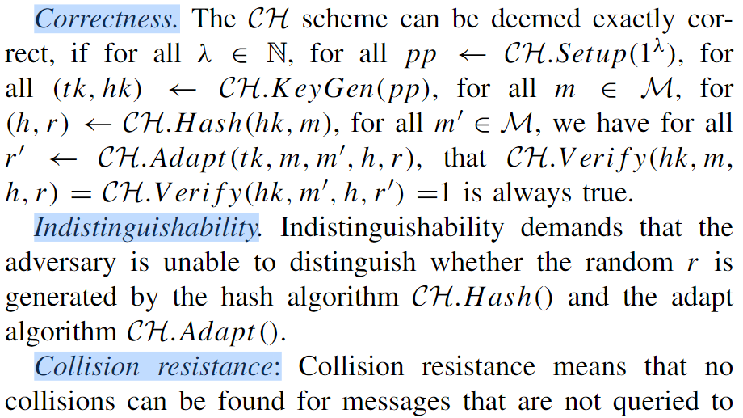
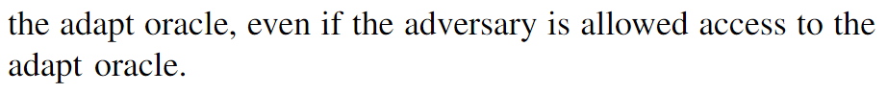
1Preliminaries-Chameleon Hash

Slide 7
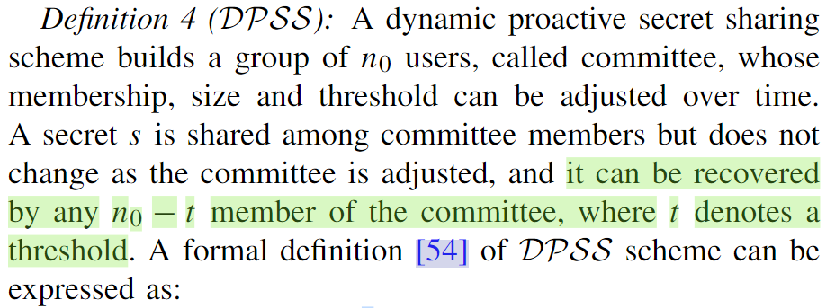
2Preliminaries-DPSS

Slide 8
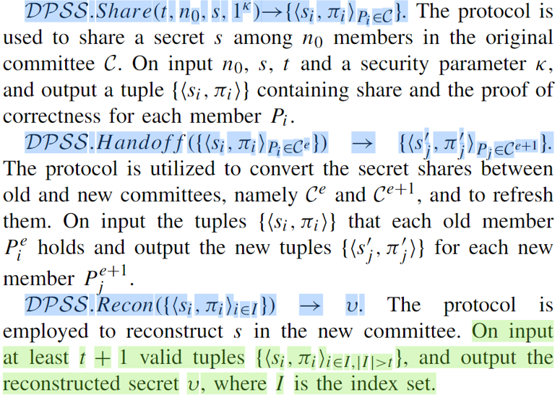
2Preliminaries-DPSS

Slide 9
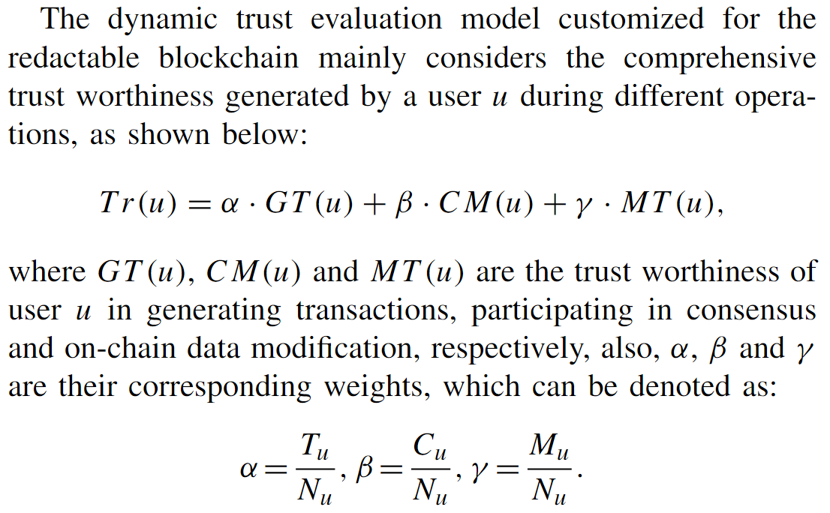
2. Dynamic Trust Worthiness

Slide 10
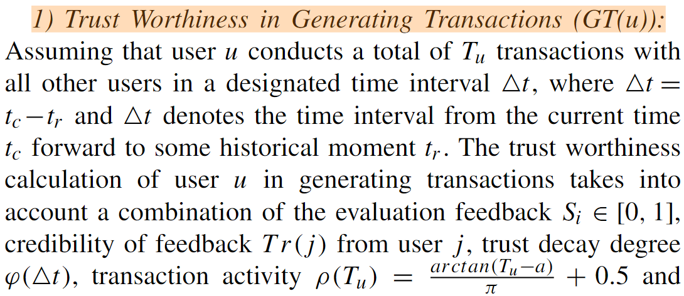
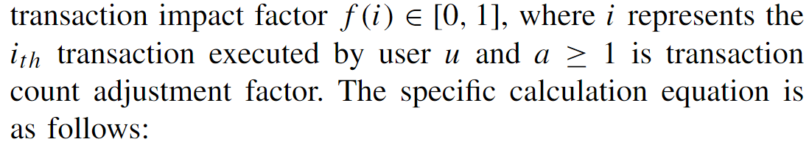
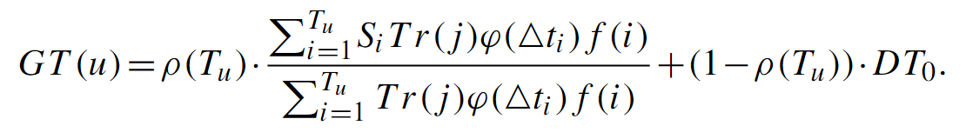
2. Dynamic Trust Worthiness

Slide 11
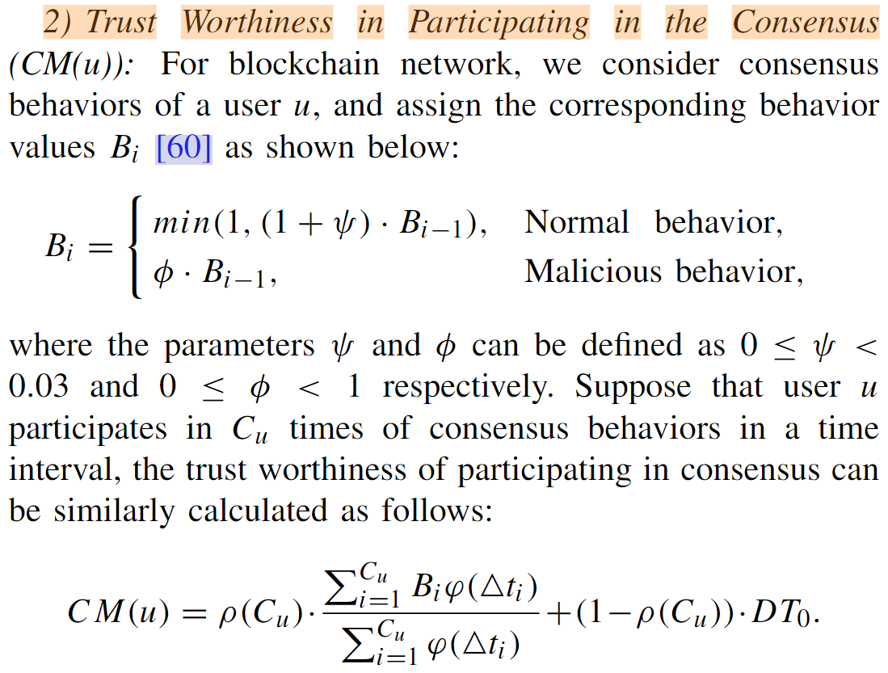
2. Dynamic Trust Worthiness

Slide 12
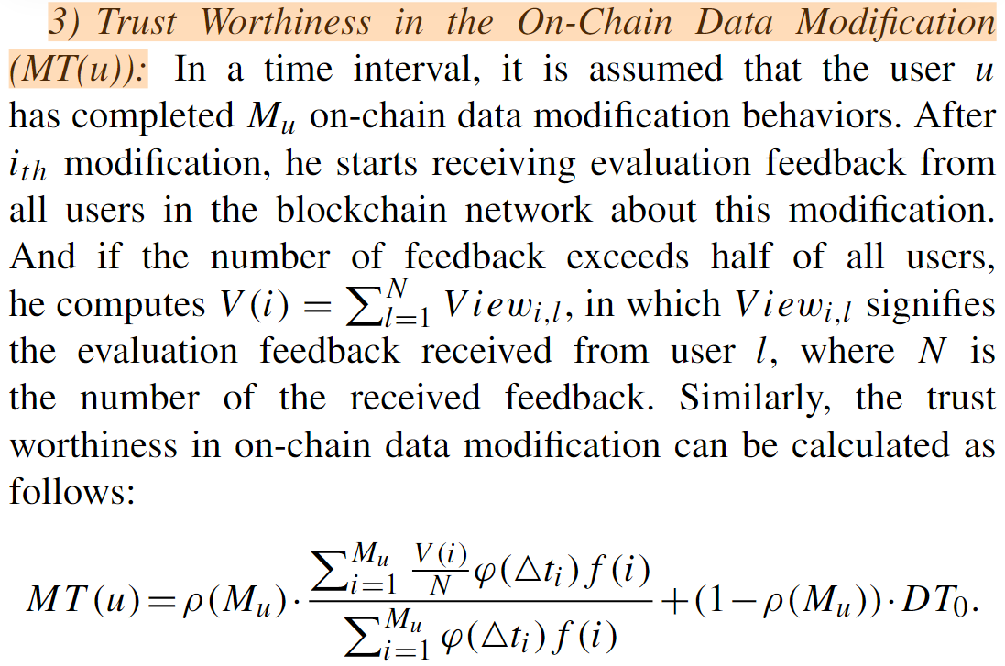
2. Dynamic Trust Worthiness

Slide 13
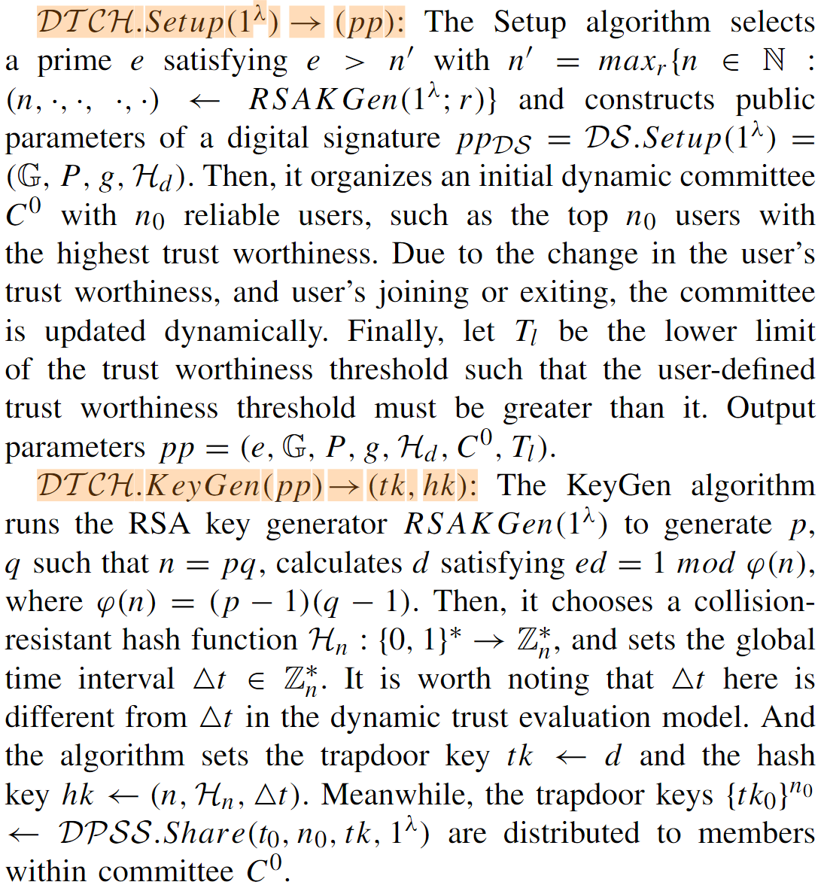
3.Construction of DTCH

Slide 14
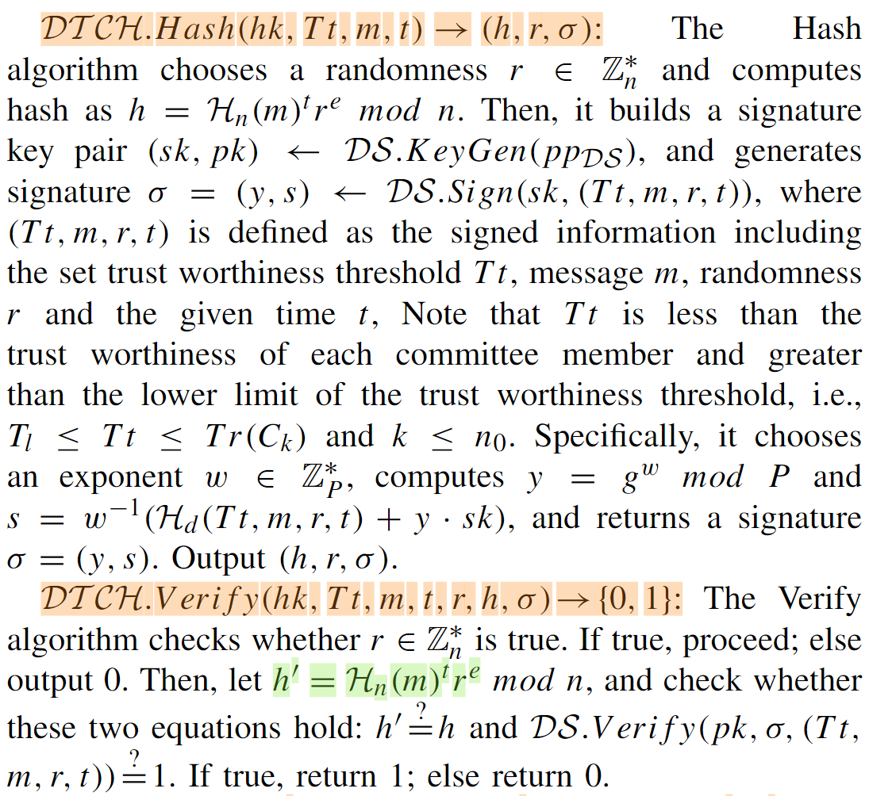
3.Construction of DTCH

Slide 15
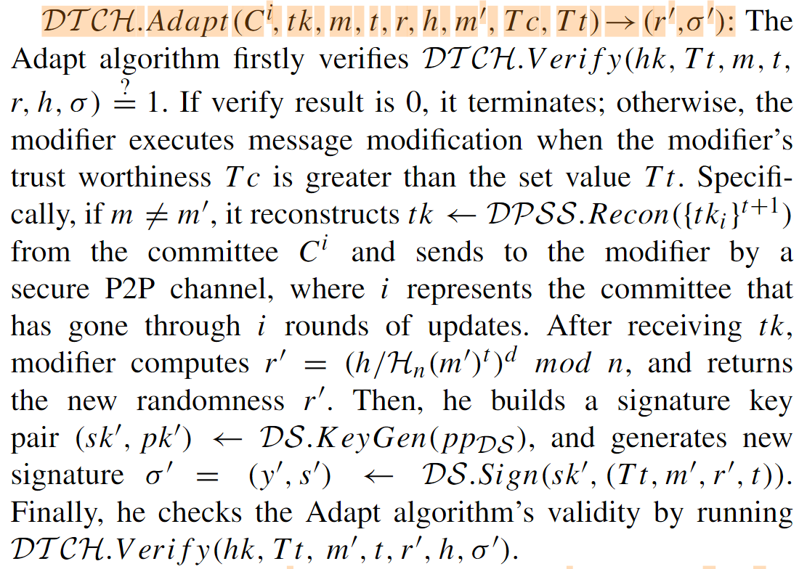
3.Construction of DTCH

Slide 16
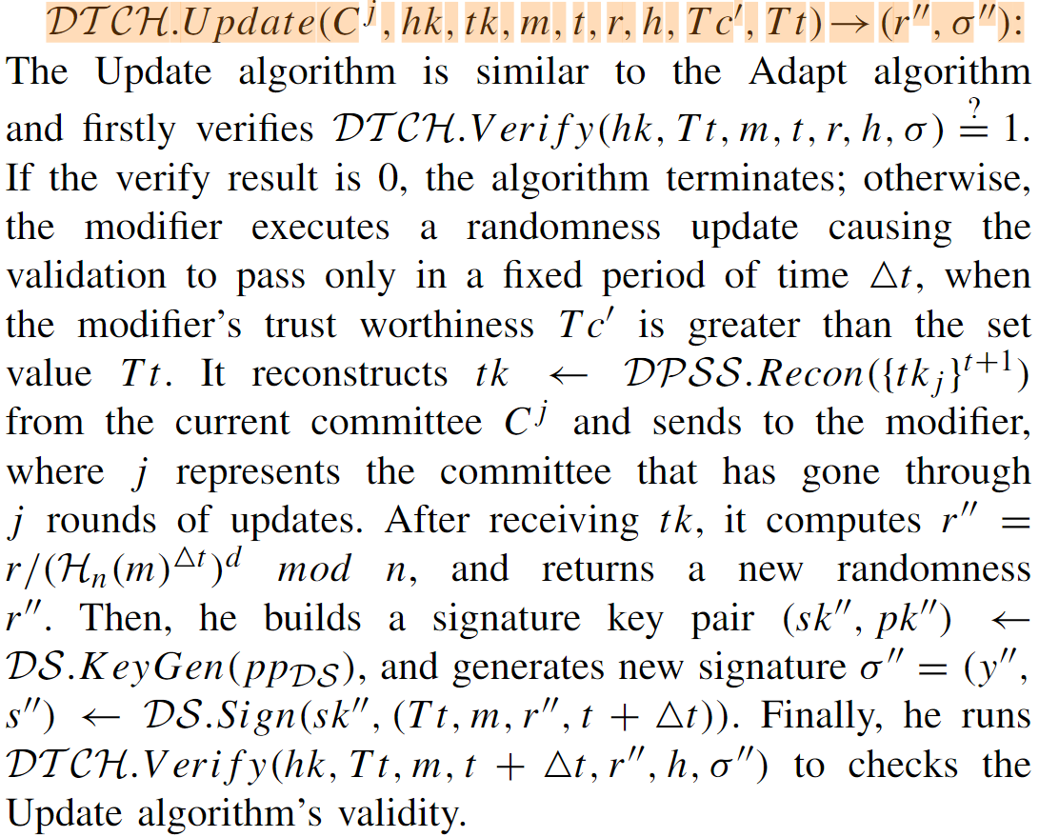
3.Construction of DTCH

Slide 17
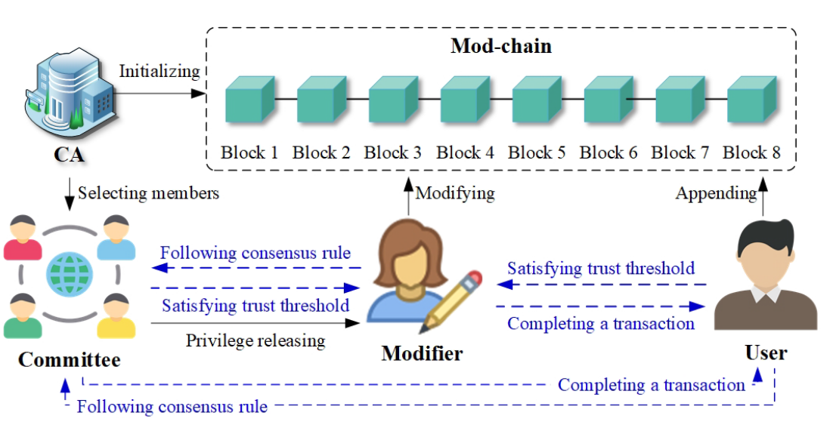
4.System Model

Slide 18
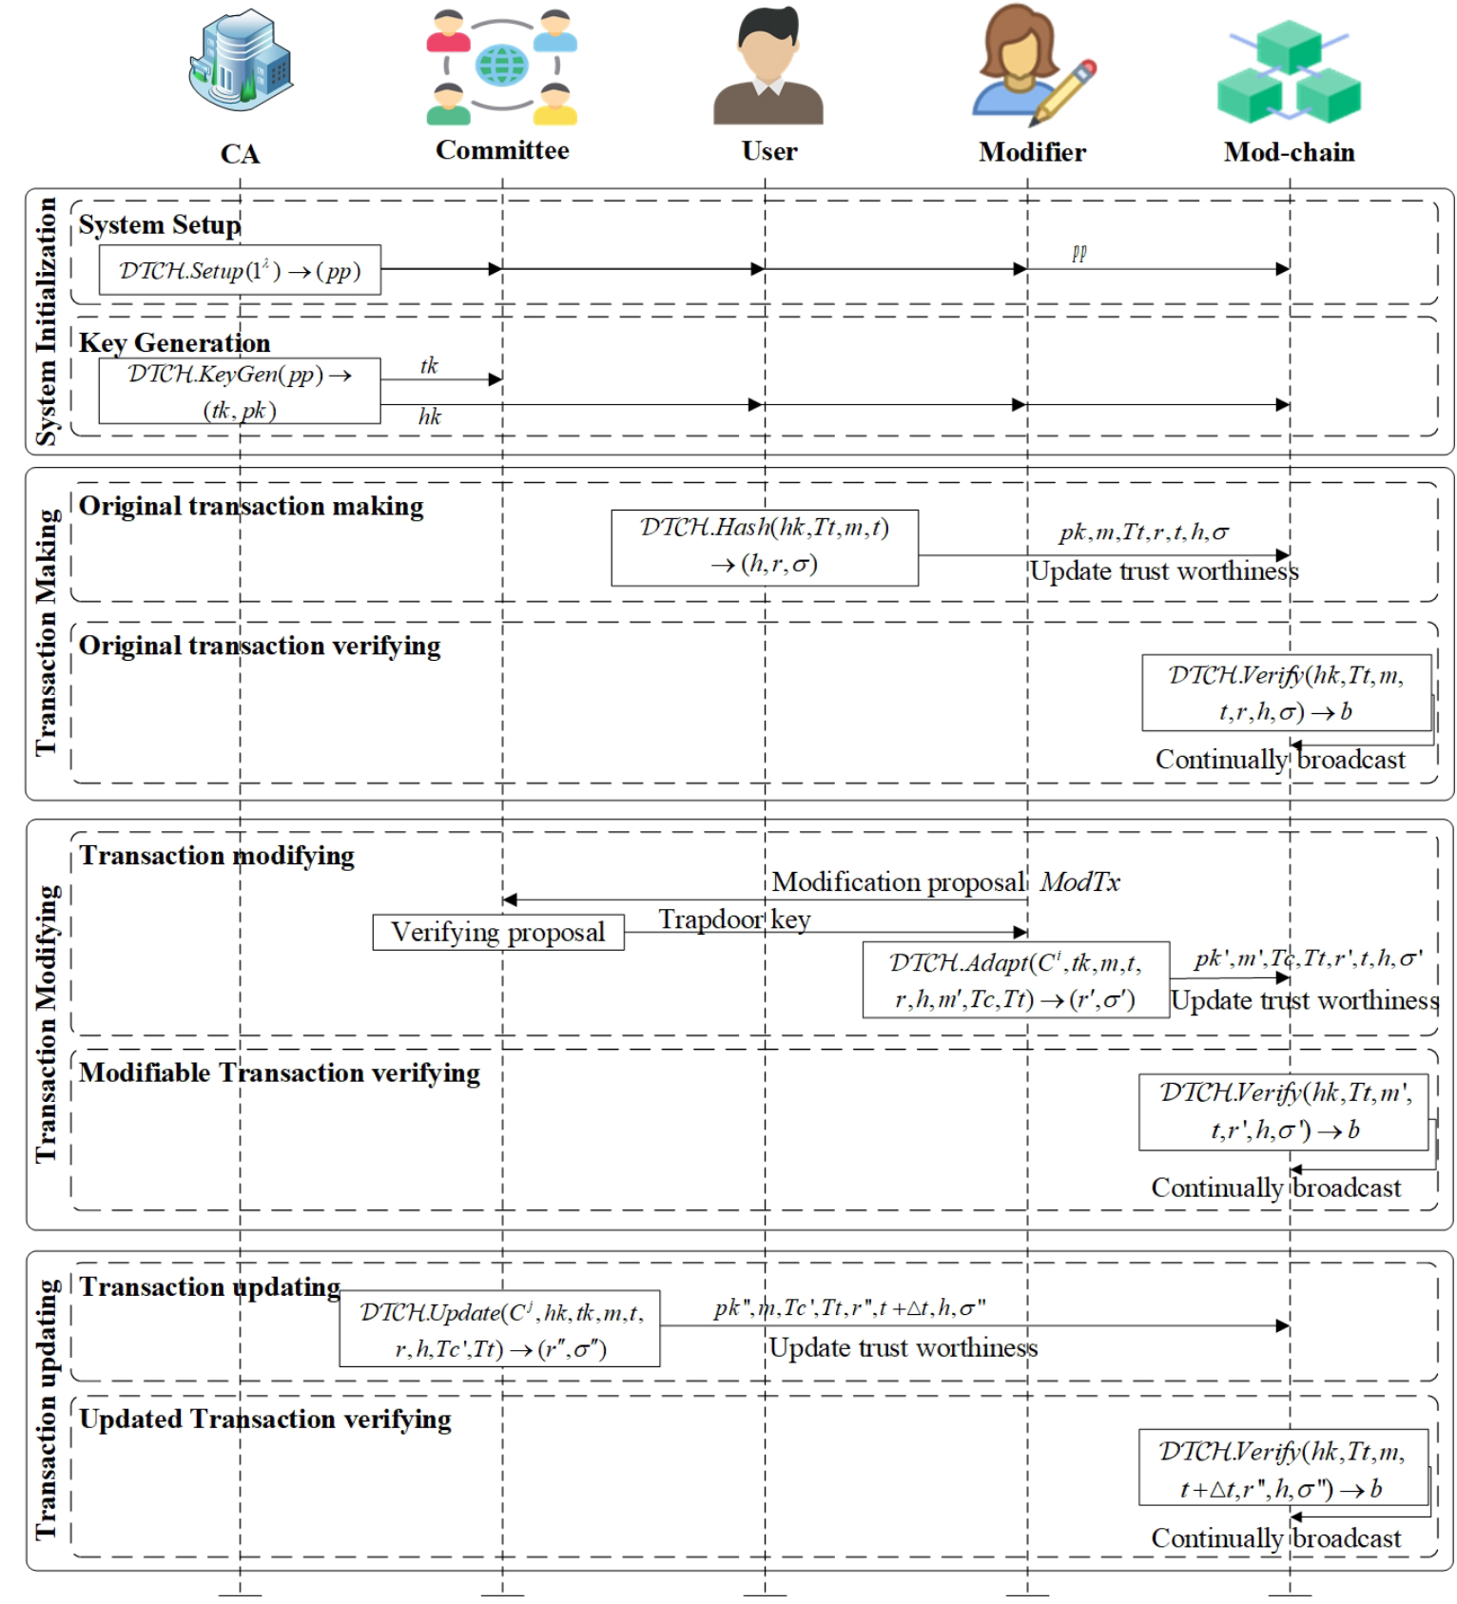
4.System Model

Slide 19
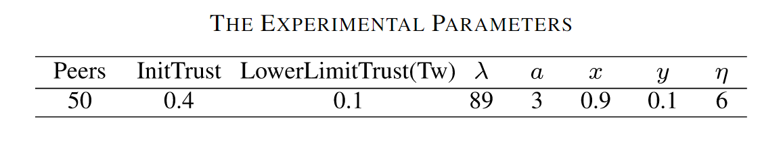
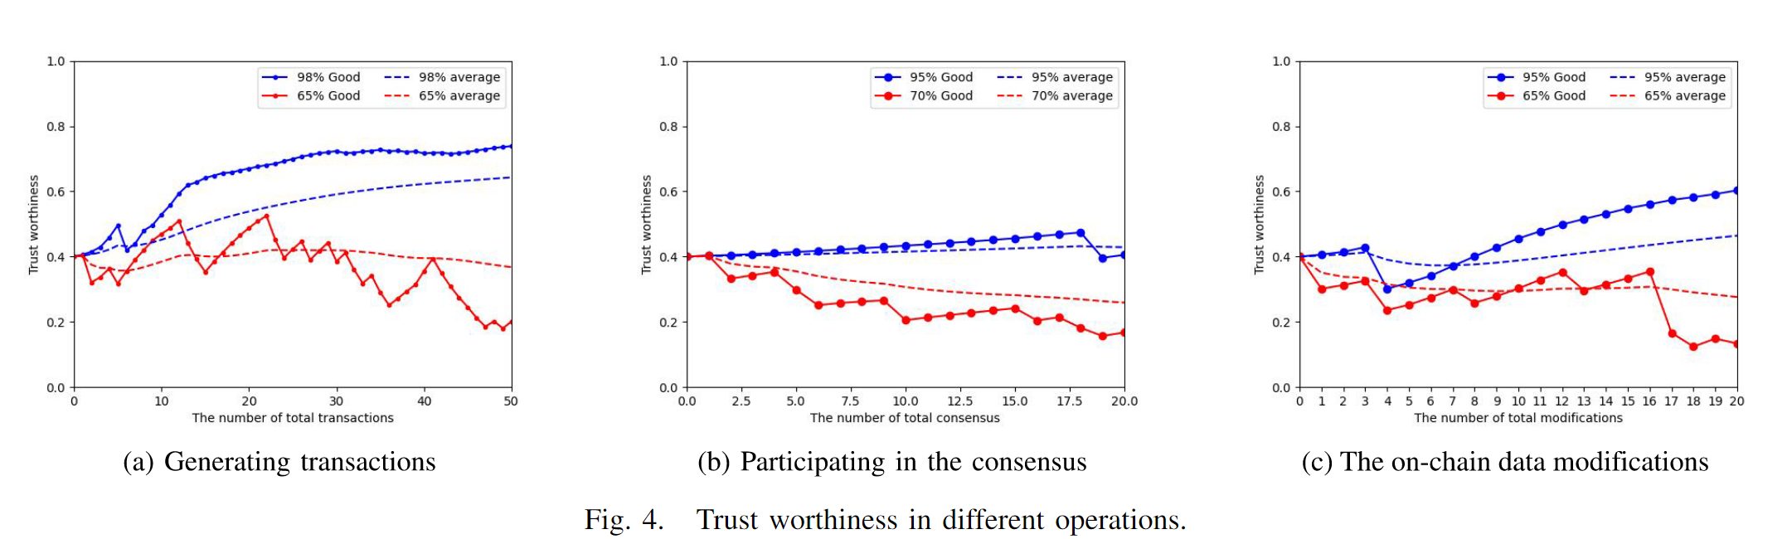
5. Performance Analysis

